Slide 1
Database Management Systems Unit 3: Relational Databases
JOINS

Slide 2
Multi-Table Queries
Can use subqueries provided result columns come from same table.
If result columns come from more than one table, we must use a join.
To perform join, include more than one table in FROM clause.
Use comma as separator with typically a WHERE to specify join column(s).

Slide 3
Multi-Table Queries
Also possible to use an alias for a table named in FROM clause.
Alias is separated from table name with a space.
Alias can be used to qualify column names when there is ambiguity.

Slide 4
Joining Tables - criteria
To appropriately join tables, the tables must be related and a where clause is applied which equates the primary key column of the table on the one side of the relationship with the parallel foreign key column of the many side table

Slide 5
Joining a Table to Itself
A join of a table to itself is called Self-Join
This table appears twice in the FROM clause and is followed by table aliases that qualify column names in the join condition
Query: Retrieve the employee number, employee name and his manager’s name from employee table
SELECT emp.emp_id, emp.emp_name, mgr.emp_name FROM employee emp, employee mgr WHERE emp.mgr_id = mgr.emp_id

Slide 6
Sentence from Table Data
Create a simple sentence by joining the pre-determined string values with column data
Example
SELECT “The balance due by Mr./Ms. “||”client_no” is ”||bal_due from payment;

Slide 7
Computing a Join
Procedure for generating results of a join are:
1. Form Cartesian product of the tables named in FROM clause.
2. If there is a WHERE clause, apply the search condition to each row of the product table, retaining those rows that satisfy the condition.
3. For each remaining row, determine value of each item in SELECT list to produce a single row in result table.
4. If DISTINCT has been specified, eliminate any duplicate rows from the result table.
5. If there is an ORDER BY clause, sort result table as required.

Slide 8
Simple Join
List all videos along with the name of the director.
SELECT catalogNo, title, category,
v.directorNo, directorName
FROM Video v, Director d
WHERE v.directorNo = d.directorNo;
Only those rows from both tables with identical values in the directorNo columns (v.directorNo = d.directorNo) included in result.

Slide 9
Four Table Join
List all videos along with name of director and names of actors and their associated roles.
SELECT v.catalogNo, title, category,
directorName, actorName, character
FROM Video v, Director d, Actor a, Role r
WHERE d.directorNo = v.directorNo AND
v.catalogNo = r.catalogNo AND
r.actorNo = a.actorNo;

Slide 10
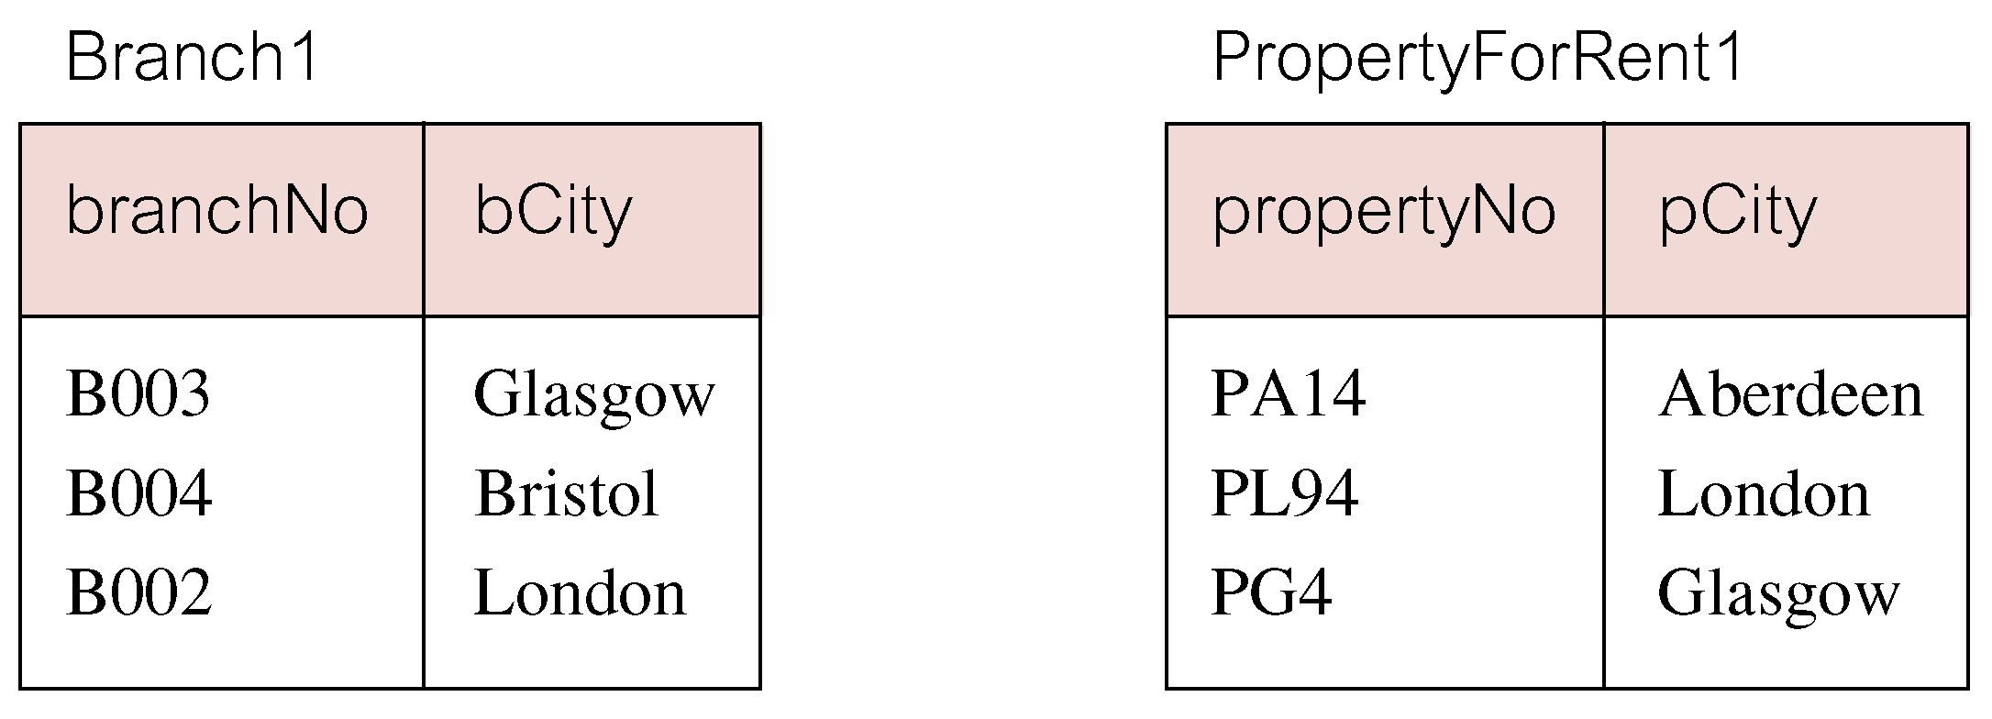
Outer Joins
If one row of a joined table is unmatched, row is omitted from result table.
Outer join operations retain rows that do not satisfy the join condition.
Consider following tables:

Slide 11
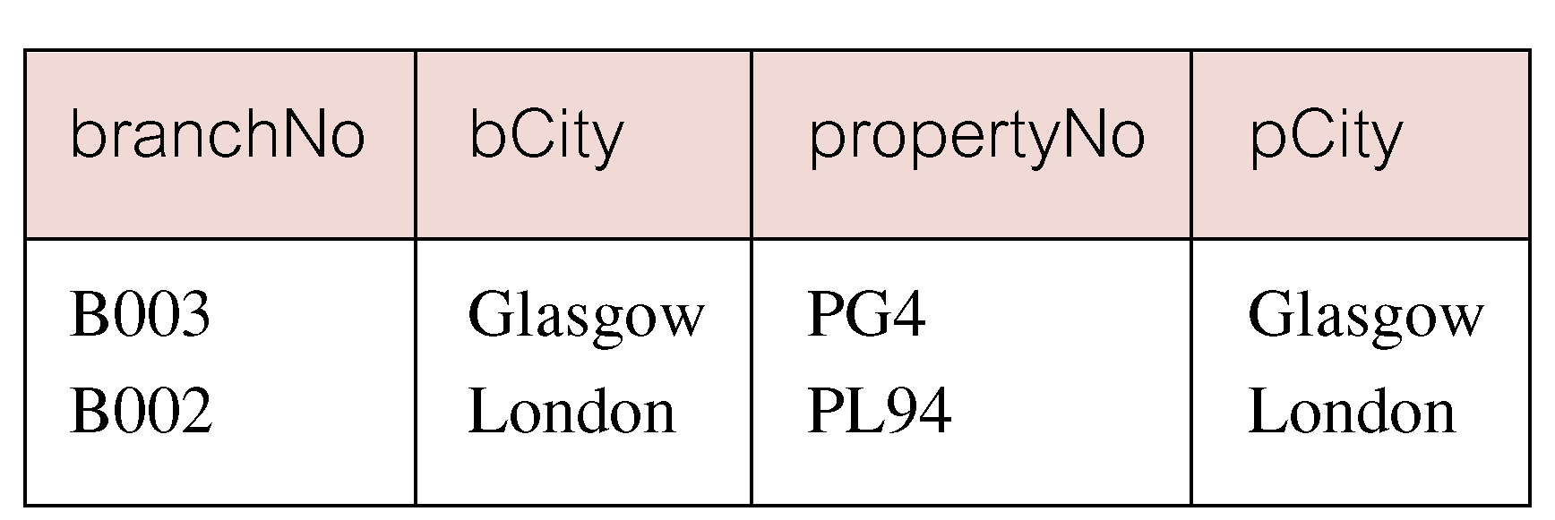
Outer Joins
The (inner) join of these two tables:
SELECT b.*, p.*
FROM Branch1 b, PropertyForRent1 p
WHERE b.bCity = p.pCity;

Slide 12
Outer Joins
Result table has two rows where cities are same.
There are no rows corresponding to branches in Bristol and Aberdeen.
To include unmatched rows in result table, use an Outer join.

Slide 13
Left Outer Join
List branches and properties that are in same city along with any unmatched branches.
SELECT b.*, p.*
FROM Branch1 b LEFT JOIN
PropertyForRent1 p ON b.bCity = p.pCity;

Slide 14
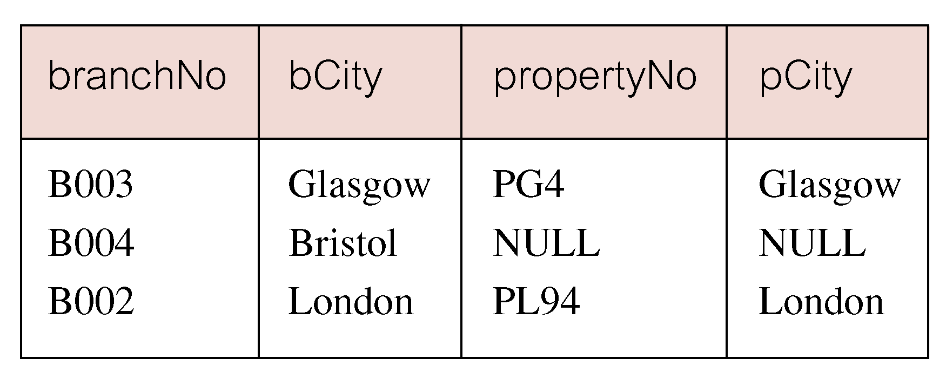
Left Outer Join
Includes those rows of first (left) table unmatched with rows from second (right) table.
Columns from second table are filled with NULLs.

Slide 15
Right Outer Join
List branches and properties in same city and any unmatched properties.
SELECT b.*, p.*
FROM Branch1 b RIGHT JOIN
PropertyForRent1 p ON b.bCity = p.pCity;

Slide 16
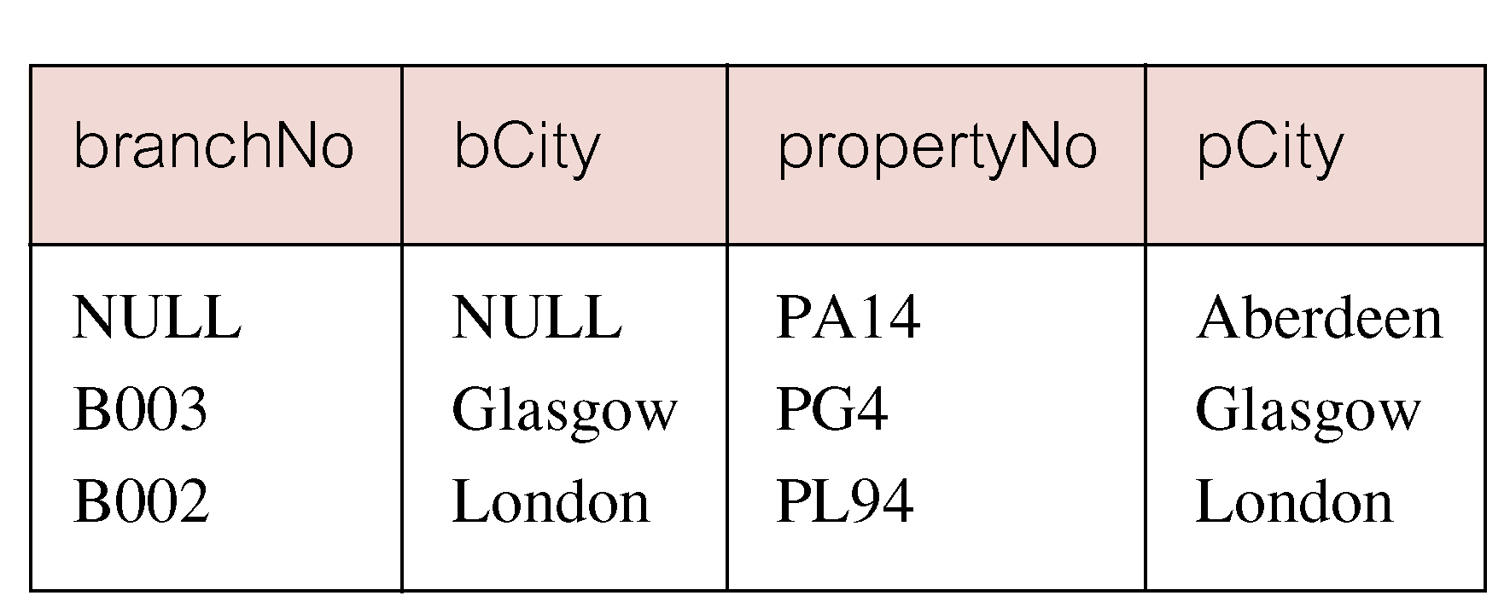
Right Outer Join
Right Outer join includes those rows of second (right) table that are unmatched with rows from first (left) table.
Columns from first table are filled with NULLs.

Slide 17
Full Outer Join
List branches and properties in same city and any unmatched branches or properties.
SELECT b.*, p.*
FROM Branch1 b FULL JOIN
PropertyForRent1 p ON b.bCity = p.pCity;

Slide 18
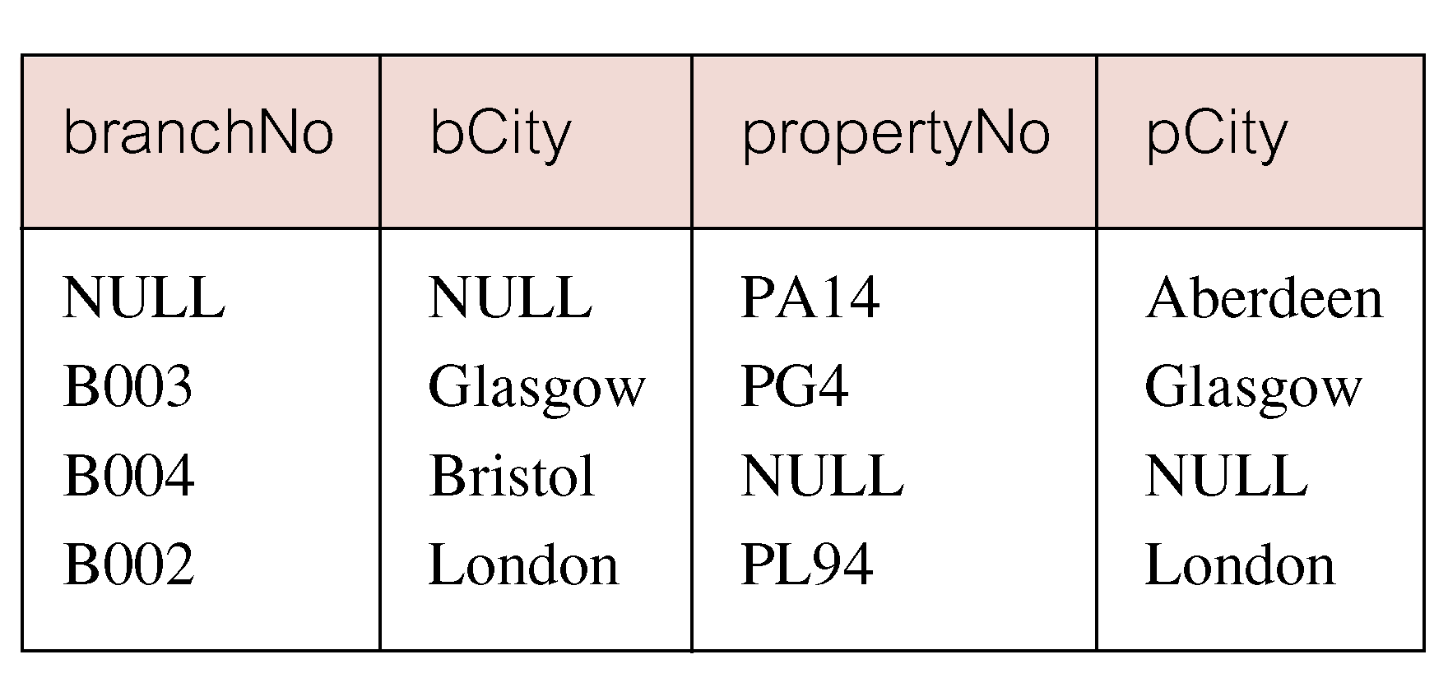
Full Outer Join
Includes rows that are unmatched in both tables.
Unmatched columns are filled with NULLs.

Slide 19
Transaction Control
The following commands are used to control transactions.
COMMIT − to save the changes.
ROLLBACK − to roll back the changes.
SAVEPOINT − creates points within the groups of transactions in which to ROLLBACK.

Slide 20
COMMIT
Transactional control commands are only used with the DML Commands such as - INSERT, UPDATE and DELETE only.
They cannot be used while creating tables or dropping them because these operations are automatically committed in the database
The COMMIT command is the transactional command used to save changes invoked by a transaction to the database.

Slide 21
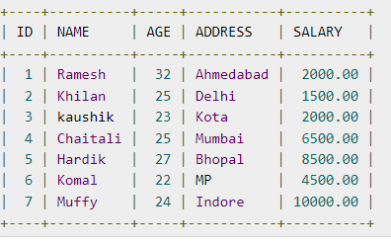
Example Consider the CUSTOMERS table having the following records

Slide 22

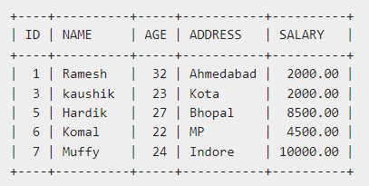
Following is an example which would delete those records from the table which have age = 25 and then COMMIT the changes in the database.
Thus, two rows from the table would be deleted and the SELECT statement would produce the following result.

Slide 23

ROLLBACK Command
The ROLLBACK command is the transactional command used to undo transactions that have not already been saved to the database.
This command can only be used to undo transactions since the last COMMIT or ROLLBACK command was issued.
The syntax for a ROLLBACK command is as follows :

Slide 24
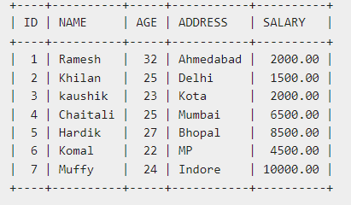

Example Consider the CUSTOMERS table having the following records
Following is an example, which would delete those records from the table which have the age = 25 and then ROLLBACK the changes in the database.

Slide 25
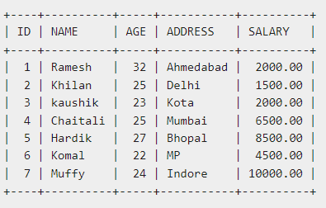
Thus, the delete operation would not impact the table and the SELECT statement would produce the following result.
select * from customers;

Slide 26


SAVEPOINT
A SAVEPOINT is a point in a transaction when you can roll the transaction back to a certain point without rolling back the entire transaction. The syntax for a SAVEPOINT command is as shown below.
This command serves only in the creation of a SAVEPOINT among all the transactional statements. The ROLLBACK command is used to undo a group of transactions.
The syntax for rolling back to a SAVEPOINT is as shown below.

Slide 27
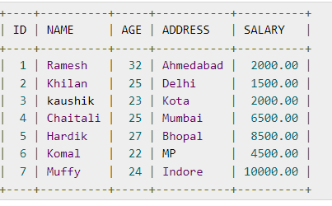
Following is an example where you plan to delete the three different records from the CUSTOMERS table. You want to create a SAVEPOINT before each delete, so that you can ROLLBACK to any SAVEPOINT at any time to return the appropriate data to its original state.
Example
Consider the CUSTOMERS table having the following records.

Slide 28
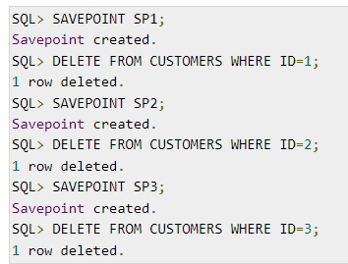

The following code block contains the series of operations.
Now that the three deletions have taken place, let us assume that you have changed your mind and decided to ROLLBACK to the SAVEPOINT that you identified as SP2. Because SP2 was created after the first deletion, the last two deletions are undone −

Slide 29
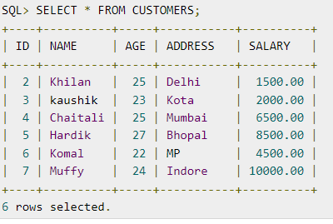
Notice that only the first deletion took place since you rolled back to SP2.

Slide 30

RELEASE SAVEPOINT Command: The RELEASE SAVEPOINT command is used to remove a SAVEPOINT that you have created.
The syntax for a RELEASE SAVEPOINT command is as follows:
Once a SAVEPOINT has been released, you can no longer use the ROLLBACK command to undo transactions performed since the last SAVEPOINT.

Slide 31
Stored Procedure
A stored procedure in SQL is a group of SQL statements that are stored together in a database.
Based on the statements in the procedure and the parameters you pass, it can perform one or multiple DML operations on the database, and return value, if any.
Stored Procedure is a function in a shared library accessible to the database server
can also write stored procedures using languages such as C or Java
: Reduced network traffic
The more SQL statements that are grouped together for execution, the larger the savings in network traffic

Slide 32
Advantages of stored procedure
Reusable: As mentioned, multiple users and applications can easily use and reuse stored procedures by merely calling it.
Easy to modify: You can quickly change the statements in a stored procedure as and when you want to, with the help of the ALTER TABLE command.
Security: Stored procedures allow you to enhance the security of an application or a database by restricting the users from direct access to the table.
Low network traffic: The server only passes the procedure name instead of the whole query, reducing network traffic.
Increases performance: Upon the first use, a plan for the stored procedure is created and stored in the buffer pool for quick execution for the next time.

Slide 33
Normal Database

Slide 34
Applications using stored procedures

Slide 35
Writing Stored Procedures
CREATE or REPLACE PROCEDURE name(parameters)
AS
variables;
BEGIN;
//statements;
END;
Three types of parameters are:
IN: It is the default parameter that will receive input value from the program
OUT: It will send output value to the program
IN OUT: It is the combination of both IN and OUT. Thus, it receives from, as well as sends a value to the program

Slide 36
EXAMPLE:
CREATE PROCEDURE UPDATE_SALARY_1 (1)
(IN EMPLOYEE_NUMBER CHAR(6), (2)
IN RATE INTEGER) (2)
LANGUAGE SQL (3)
BEGIN
UPDATE EMPLOYEE (4)
SET SALARY = SALARY * (1.0 * RATE / 100.0 )
WHERE SSN = EMPLOYEE_NUMBER;
END
LANGUAGE value of SQL and the BEGIN...END block, which forms the procedure body, are particular to an SQL procedure
1)The stored procedure name is UPDATE_SALARY_1.
2)The two parameters have data types of CHAR(6) and INTEGER. Both are input parameters.
3)LANGUAGE SQL indicates that this is an SQL procedure, so a procedure body follows the other parameters.
4)The procedure body consists of a single SQL UPDATE statement, which updates rows in the employee table.

Slide 37
Some Valid SQL Procedure Body Statements
CASE statement
FOR statement
GOTO statement
IF statement
ITERATE statement
RETURN statement
WHILE statement

Slide 38
Invoking Procedures
Can invoke Stored procedure stored at the location of the database by using the SQL CALL statement
Nested SQL Procedures:
To call a target SQL procedure from within a caller SQL procedure, simply include a CALL statement with the appropriate number and types of parameters in your caller.
CREATE PROCEDURE NEST_SALES(OUT budget DECIMAL(11,2))
LANGUAGE SQL
BEGIN
DECLARE total INTEGER DEFAULT 0;
SET total = 6;
CALL SALES_TARGET(total);
SET budget = total * 10000;
END

Slide 39
CONDITIONAL STATEMENTS:
IF <condition> THEN
<statement(s)>
ELSE
<statement(s)>
END IF;
Loops
LOOP
……
EXIT WHEN <condition> ……
END LOOP;

Slide 40
EXAMPLE :
CREATE PROCEDURE UPDATE_SALARY_IF
(IN employee_number CHAR(6), IN rating SMALLINT)
LANGUAGE SQL
BEGIN
SET counter = 10;
WHILE (counter > 0) DO
IF (rating = 1)
THEN UPDATE employee
SET salary = salary * 1.10, bonus = 1000
WHERE empno = employee_number;
ELSEIF (rating = 2)
THEN UPDATE employee
SET salary = salary * 1.05, bonus = 500
WHERE empno = employee_number;
ELSE UPDATE employee
SET salary = salary * 1.03, bonus = 0
WHERE empno = employee_number;
END IF;
SET counter = counter – 1;
END WHILE;
END
@

Slide 41

Structure of PL/SQL
PL/SQL is Block Structured
A block is the basic unit from which all PL/SQL programs are built. A block can be named (functions and procedures) or anonymous
Sections of block
1- Header Section
2- Declaration Section
3- Executable Section
4- Exception Section

Slide 42
Structure of PL/SQL
HEADER
Type and Name of block
DECLARE
Variables; Constants; Cursors;
BEGIN
PL/SQL and SQL Statements
EXCEPTION
Exception handlers
END;

Slide 43
Structure of PL/SQL
DECLARE
a number;
text1 varchar2(20);
text2 varchar2(20) := “HI”;
BEGIN
---------- ---------- ----------
END;
Important Data Types in PL/SQL include NUMBER, INTEGER, CHAR, VARCHAR2, DATE etc
to_date(‘02-05-2007','dd-mm-yyyy') { Converts String to Date}

Slide 44
Structure of PL/SQL
Data Types for specific columns
Variable_name Table_name.Column_name%type;
This syntax defines a variable of the type of the referenced column on the referenced table

Slide 45
PL/SQL Control Structure
PL/SQL has a number of control structures which includes:
Conditional controls
Iterative or loop controls.
Exception or error controls
It is these controls, used singly or together, that allow the PL/SQL developer to direct the flow of execution through the program.

Slide 46
PL/SQL Control Structure
Conditional Controls
IF....THEN....END IF;
IF....THEN...ELSE....END IF;
IF....THEN...ELSIF....THEN....ELSE....END IF;

Slide 47
PL/SQL Control Structure
LOOP
...SQL Statements...
EXIT;
END LOOP;
WHILE loops
WHILE condition LOOP
...SQL Statements...
END LOOP;
FOR loops
FOR <variable(numeric)> IN [REVERSE] <lowerbound>..<upperbound> LOOP .... ..... END LOOP;

Slide 48
Example-1(Constants)
PI CONSTANT NUMBER := 3.141592654;
DECLARE
-- constant declaration
pi constant number := 3.141592654;
-- other declarations
radius number(5,2);
dia number(5,2);
circumference number(7, 2);
area number (10, 2);
BEGIN
-- processing
radius := 9.5;
dia := radius * 2;
circumference := 2.0 * pi * radius;
area := pi * radius * radius;
-- output
dbms_output.put_line('Radius: ' || radius);
dbms_output.put_line('Diameter: ' || dia);
dbms_output.put_line('Circumference: ' || circumference);
dbms_output.put_line('Area: ' || area);
END;
Output:
Radius: 9.5
Diameter: 19
Circumference: 59.69
Area: 283.53

Slide 49
Example-2(Loops)
DECLARE
i number(1);
j number(1);
BEGIN
<< outer_loop >>
FOR i IN 1..3 LOOP
<< inner_loop >>
FOR j IN 1..3 LOOP
dbms_output.put_line('i is: '|| i || ' and j is: ' || j);
END loop inner_loop;
END loop outer_loop;
END;
/
Output:
i is: 1 and j is: 1
i is: 1 and j is: 2
i is: 1 and j is: 3
i is: 2 and j is: 1
i is: 2 and j is: 2
i is: 2 and j is: 3
i is: 3 and j is: 1
i is: 3 and j is: 2
i is: 3 and j is: 3

Slide 50
Example-3(Strings)
DECLARE
name varchar2(20);
company varchar2(30);
introduction clob;
choice char(1);
BEGIN
name := 'John Smith';
company := 'Infotech';
introduction := ' Hello! I''m John Smith from Infotech.';
choice := 'y';
IF choice = 'y' THEN
dbms_output.put_line(name);
dbms_output.put_line(company);
dbms_output.put_line(introduction);
END IF;
END;
/
Output:
John Smith
Infotech
Hello! I'm John Smith from Infotech.

Slide 51
Example-4(Arrays)
DECLARE
type namesarray IS VARRAY(5) OF VARCHAR2(10);
type grades IS VARRAY(5) OF INTEGER;
names namesarray;
marks grades;
total integer;
BEGIN
names := namesarray('Kavita', 'Pritam', 'Ayan', 'Rishav', 'Aziz');
marks:= grades(98, 97, 78, 87, 92);
total := names.count;
dbms_output.put_line('Total '|| total || ' Students');
FOR i in 1 .. total LOOP
dbms_output.put_line('Student: ' || names(i) || '
Marks: ' || marks(i));
END LOOP;
END;
/
Output:
Total 5 Students
Student: Kavita Marks: 98
Student: Pritam Marks: 97
Student: Ayan Marks: 78
Student: Rishav Marks: 87
Student: Aziz Marks: 92

Slide 52
Example-5(Procedure)
DECLARE
a number;
b number;
c number;
PROCEDURE findMin(x IN number, y IN number, z OUT number) IS
BEGIN
IF x < y THEN
z:= x;
ELSE
z:= y;
END IF;
END;
BEGIN
a:= 23;
b:= 45;
findMin(a, b, c);
dbms_output.put_line(' Minimum of (23, 45) : ' || c);
END;
/
Output:
Minimum of (23, 45) : 23

Slide 53
Example-6 (Function)
DECLARE
a number;
b number;
c number;
FUNCTION findMax(x IN number, y IN number)
RETURN number
IS
z number;
BEGIN
IF x > y THEN
z:= x;
ELSE
Z:= y;
END IF;
RETURN z;
END;
BEGIN
a:= 23;
b:= 45;
c := findMax(a, b);
dbms_output.put_line(' Maximum of (23,45): ' || c);
END;
/
Output:
Maximum of (23,45): 45

Slide 54
Triggers
A trigger is a stored procedure in database which automatically invokes whenever a special event in the database occurs. For example, a trigger can be invoked when a row is inserted into a specified table or when certain table columns are being updated.
Triggers are composed to be executed in light of any of the accompanying occasions.
A database control (DML) statement (DELETE, INSERT, or UPDATE).
A database definition (DDL) statement (CREATE, ALTER, or DROP).
A database operation (SERVERERROR, LOGON, LOGOFF, STARTUP, or SHUTDOWN).

Slide 55
The syntax of Triggers in SQL–
CREATE [OR REPLACE ] TRIGGER trigger_name
{BEFORE | AFTER | INSTEAD OF }
{INSERT [OR] | UPDATE [OR] | DELETE}
[OF col_name]
ON table_name
[REFERENCING OLD AS o NEW AS n]
[FOR EACH ROW]
WHEN (condition)
DECLARE
Declaration-statements
BEGIN
Executable-statements
EXCEPTION
Exception-handling-statements
END;
Create [OR REPLACE] TRIGGER trigger_name: It makes or replaces a current trigger with the trigger_name.

Slide 56
EXAMPLE
CREATE OR REPLACE TRIGGER display_salary_changes
BEFORE DELETE OR INSERT OR UPDATE ON customers
FOR EACH ROW
WHEN (NEW.ID > 0)
DECLARE
sal_diff number;
BEGIN
sal_diff := :NEW.salary - :OLD.salary;
dbms_output.put_line('Old salary: ' || :OLD.salary);
dbms_output.put_line('New salary: ' || :NEW.salary);
dbms_output.put_line('Salary difference: ' || sal_diff);
END;

Slide 57
After creating a Trigger, use it in the PL/SQL code for putting it in to action.
DECLARE
total_rows number(2);
BEGIN
UPDATE customers
SET salary = salary + 5000;
IF sql%notfound THEN
dbms_output.put_line('no customers updated');
ELSIF sql%found THEN
total_rows := sql%rowcount;
dbms_output.put_line( total_rows || ' customers updated ');
END IF;
END;
/

Slide 58
Advantages of Triggers
Triggers can be written for the following purposes −
Generating some derived column values automatically
Enforcing referential integrity
Event logging and storing information on table access
Auditing
Synchronous replication of tables
Imposing security authorizations
Preventing invalid transactions

Slide 59
Exception Handling
An exception is an error condition during a program execution. PL/SQL supports programmers to catch such conditions using EXCEPTION block in the program and an appropriate action is taken against the error condition. There are two types of exceptions −
- System-defined exceptions
- User-defined exceptions

Slide 60
Exception Handling
Syntax for Exception Handling
The general syntax for exception handling is as follows. Here we can list down as many exceptions as we can handle. The default exception will be handled using WHEN others THEN −
DECLARE
<declarations section>
BEGIN
<executable command(s)>
EXCEPTION
<exception handling goes here >
WHEN exception1 THEN
exception1-handling-statements
WHEN exception2 THEN
exception2-handling-statements
WHEN exception3 THEN
exception3-handling-statements
........
WHEN others THEN
exception-handling-statements
END;

Slide 61
Example
DECLARE
c_id customers.id%type := 8;
c_name customerS.Name%type;
c_addr customers.address%type;
BEGIN
SELECT name, address INTO c_name, c_addr
FROM customers
WHERE id = c_id;
DBMS_OUTPUT.PUT_LINE ('Name: '|| c_name);
DBMS_OUTPUT.PUT_LINE ('Address: ' || c_addr);
EXCEPTION
WHEN no_data_found THEN
dbms_output.put_line('No such customer!');
WHEN others THEN
dbms_output.put_line('Error!');
END;
/
Output:
No such customer!

Slide 62
PostgreSQL Overview
PostgreSQL is an ORDBMS [Open-Source Object-Relational Database Management System]. It is used to store data securely; supporting best practices, and allow recovering them when the request is processed.
It is one of the most popular databases supporting JSON (non-relational) queries and SQL for (relational) queries. PostgreSQL is an object-relational database management system (ORDBMS).
It contains the various advanced data types and robust feature sets, which increase the extensibility, reliability, and data integrity of the software.

Slide 63
PostgreSQL commands
ABORT command:
Syntax:
ABORT [ WORK | TRANSACTION ]
ALTER AGGREGATE command:
Syntax:
ALTER AGGREGATE name ( type ) RENAME TO new_name
ALTER AGGREGATE name ( type ) OWNER TO new_owner

Slide 64
PostgreSQL commands
ALTER CONVERSION command:
Syntax:
ALTER CONVERSION name RENAME TO new_name
ALTER CONVERSION name OWNER TO new_owner
ALTER DATABASE command:
Syntax:
ALTER DATABASE name SET parameter { TO | = } { value | DEFAULT }
ALTER DATABASE name RESET parameter
ALTER DATABASE name RENAME TO new_name
ALTER DATABASE name OWNER TO new_owner

Slide 65
PostgreSQL commands
CREATE TABLE:
Syntax:
CREATE [ [ GLOBAL | LOCAL ] { TEMPORARY | TEMP } ] TABLE table_name (
{ column_name data_type [ DEFAULT default_expr ] [ column_constraint [ ... ] ]
| table_constraint
| LIKE parent_table [ { INCLUDING | EXCLUDING } DEFAULTS ] } [, ... ]
)
[ INHERITS ( parent_table [, ... ] ) ]
[ WITH OIDS | WITHOUT OIDS ]
[ ON COMMIT { PRESERVE ROWS | DELETE ROWS | DROP } ]
[ TABLESPACE tablespace ]

